Slide 1
PROJECT DEFENSE
BY
MAJI Emmanuel Simon
2017/1/68562CT
Project Supervisor: Dr. Oluwaseun A. Ojerinde

Slide 2
TABLE OF CONTENT
Project Title 1
Introduction 2
Background of the Study 3
Statement of Problem 4
Aim & Objectives 5
Significance of the Study 6
Scopes & Limitation 7
Literature Review 8
Related Works 9
Methodology & Scope of Build 10
Results 11
Summary & Conclusion 12
References 13

Slide 3
Digital/Online Sport Registration Platform

Slide 4
RATIO OF NIGERIAN STUDENTS
IN EDUCATION TO SPORTS

Slide 5
PERCENTAGE OF NIGERIAN STUDENTS IN SPORTS

Slide 6
BACKGROUND OF THE STUDY
The study of digitalizing the registration process for aspiring sport athletes addresses the growing demand for streamlined, user-friendly, and efficient systems in the sports industry. The background of this study involves understanding the traditional methods of sports registration, identifying the challenges they present, and recognizing the benefits of digital transformation.

Slide 7
STATEMENT OF PROBLEM
VISIBILITY:
Sport in Nigeria generally has very good impact on health sector, as much as education/academics is important so is sport, sadly sport has no much visibility like academics. Sport enthusiast always get lesser reach, regardless of their talents, this has been a basic factor against sports growth.

Slide 8
AIM AND OBJECTIVES
AIM:
The aim of this project is to design a digital/online sport registration platform for young aspiring athletes, to grant them access to a user friendly platform that enables them showcase their skills and talent for proper acknowledgment.

Slide 9
AIM AND OBJECTIVES
OBJECTIVES:
Research on Sports & Registration Steps and Procedurces
Design a User Friendly Sport Registration Platform
Implement the system
Test and Optimize for Users across Multiple Devices

Slide 10
SIGNIFICANCE OF THE STUDY
The significance of this study encompasses a major set back in Nigeria, Poverty. This project is expected to give visibilty and opportunity to the less privelegde and the average talented athlete to showcase their skills and talents to be given proper acknowlegements.

Slide 11
SCOPES AND LIMITATIONS
SCOPES:
Efficiency and Convenience
Automated Processes
Data Management and Analysis
User Experience
Cost Reduction

Slide 12
SCOPES AND LIMITATIONS
LIMITATION:
Accessibility
Usability Concerns
Ongoing Maintenance
Regulatory and Compliance Issues

Slide 13
LITERATURE REVIEW
Design and Implementation of Smartphone Application for Badminton sports community. Journal of Physics Conference Series. Indonesia (March 2020) Nizirwan Anwar, Eric HendroAsali, Heryanto, Teddy Budiyanto
The design and implementation of sports competition registration system based on SSH framework system (January 2017) Revista de la Facultad de Ingeniería. C. Wang, N. Gao
Design and Implementation of Online Booking System of University Sports Venues (January 2017) MATEC Web of Conferences. Can Li, Junjie Li, Zhang Meng
Analysis and Design of Training Room Reservation Management System Based on SSH Framework Journal of Physics Conference Series (August 2019) Ting Wang, Chuamfeng Bie.

Slide 14
REVIEW OF RELATED WORKS
S/N | Authors | Descriptions | Contributions | Limitations
1 | (Palomar et al., 2020) | Developed BIMlegacy platform for collaboration in heritage architecture | Integrates Heritage Building Information Modelling (HBIM) with other databases for better collaboration | System complexity and limited scalability for large projects
2 | (Lin et al., 2022) | Used the Kano model and Means-End Chain analysis to design a hospital online registration system tailored to user preferences. | Enhanced patient satisfaction by tailoring the system to user needs, improving the registration process | Lacks analysis on scalability and long-term system adaptability.
3 | (Liu & Zhu, 2022) | Implemented an online registration system using Mendix, a low-code platform, to streamline basic registration functions | Demonstrated the efficiency of low-code platforms for rapid deployment of registration systems | Limited adaptability for complex, evolving system requirements
4 | (Syahidin et al., 2022) | Developed an online vaccination registration system to reduce queues and minimize COVID-19 risks by enabling remote appointment bookings. | Improved efficiency in vaccination scheduling and reduced in-person interactions during the pandemic | Lacks solutions for potential server overload and delays during high- demand periods.

Slide 15

METHODOLOGY & SCOPE OF BUILD
FULL NAME
SEX/GENDER
DATE OF BIRTH
MARITAL STATUS
SPORT PREFERENCE (FOOTBALL/BASKETBALL)
ADDRESS
PHONE NUMBER
EMAIL ADDRESS
NEXT OF KIN INFORMATION
SCOUTS

Slide 16

METHODOLOGY & SCOPE OF BUILD
FULL NAME
SEX/GENDER
DATE OF BIRTH
MARITAL STATUS
HEIGHT
WEIGHT
SPORT PREFRENCE (FOOTBALL/BASKETBALL)
ADDRESS
PHONE NUMBER
EMAIL ADDRESS
NEXT OF KIN INFORMATION
BLOOD GROUP/GENOTYPE
YOUTUBE LINK
ATHLETES

Slide 17

METHODOLOGY & SCOPE OF BUILD
ATHLETES
SCOUTS REQUIREMENTS
ADMIN
SCOUT/ATHELETES DASHBOARD
SCOUTS
ATHELETES
REQUIREMENTS

Slide 18

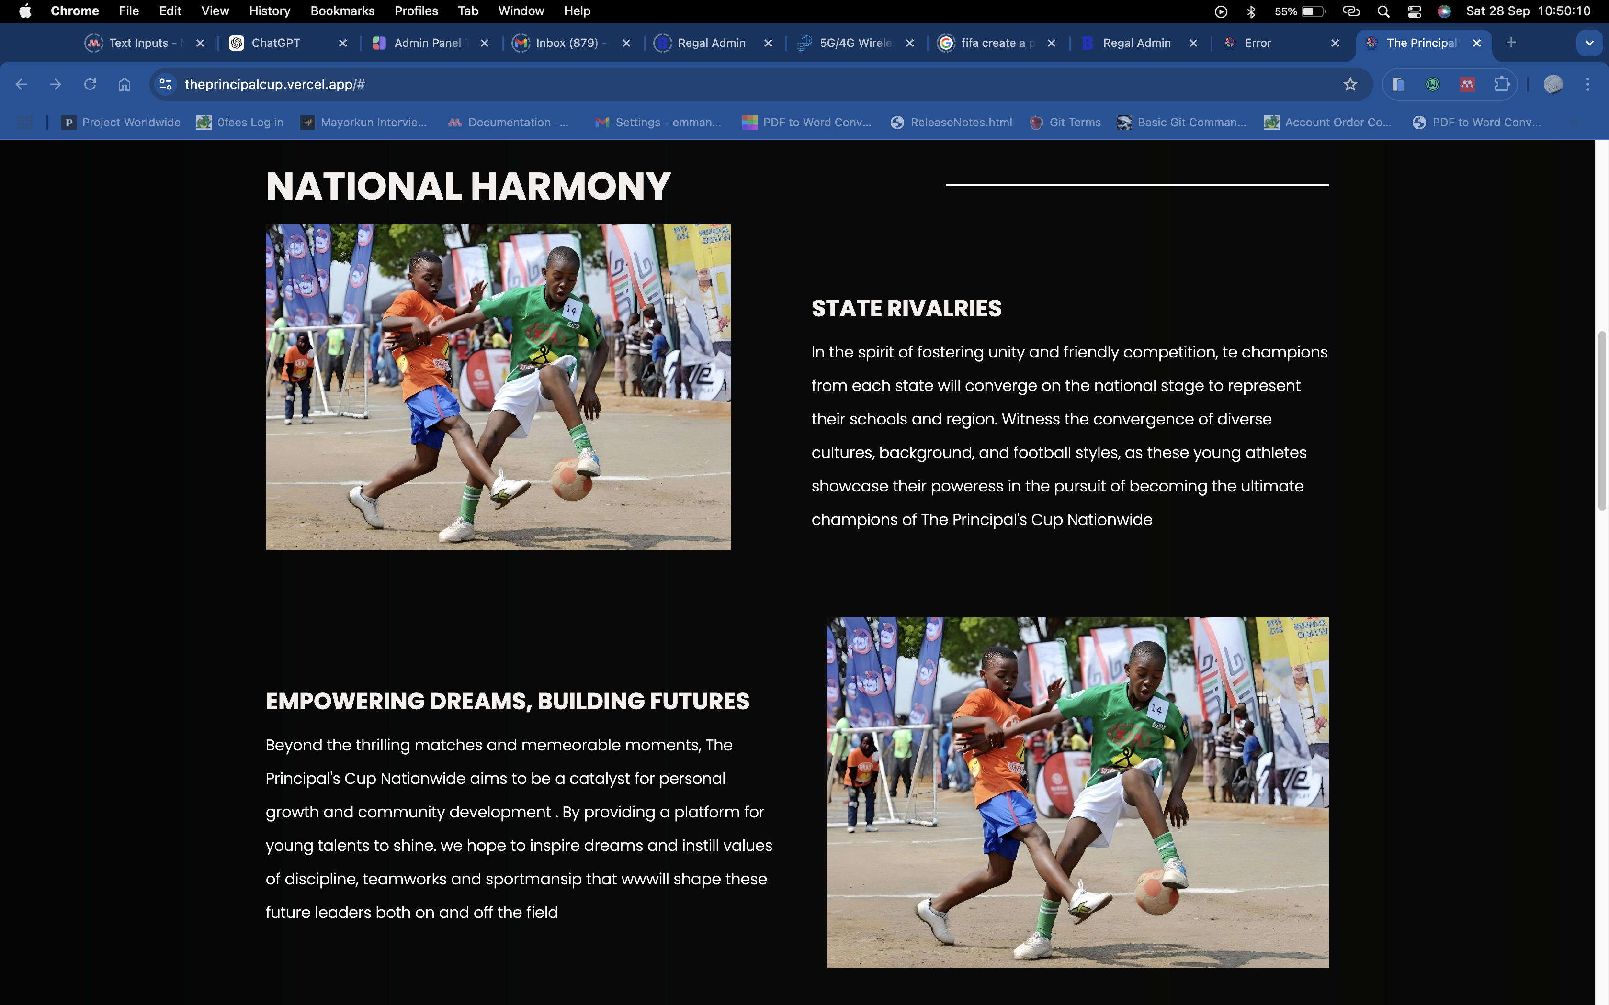


RESULTS
Landing Page:

Slide 19
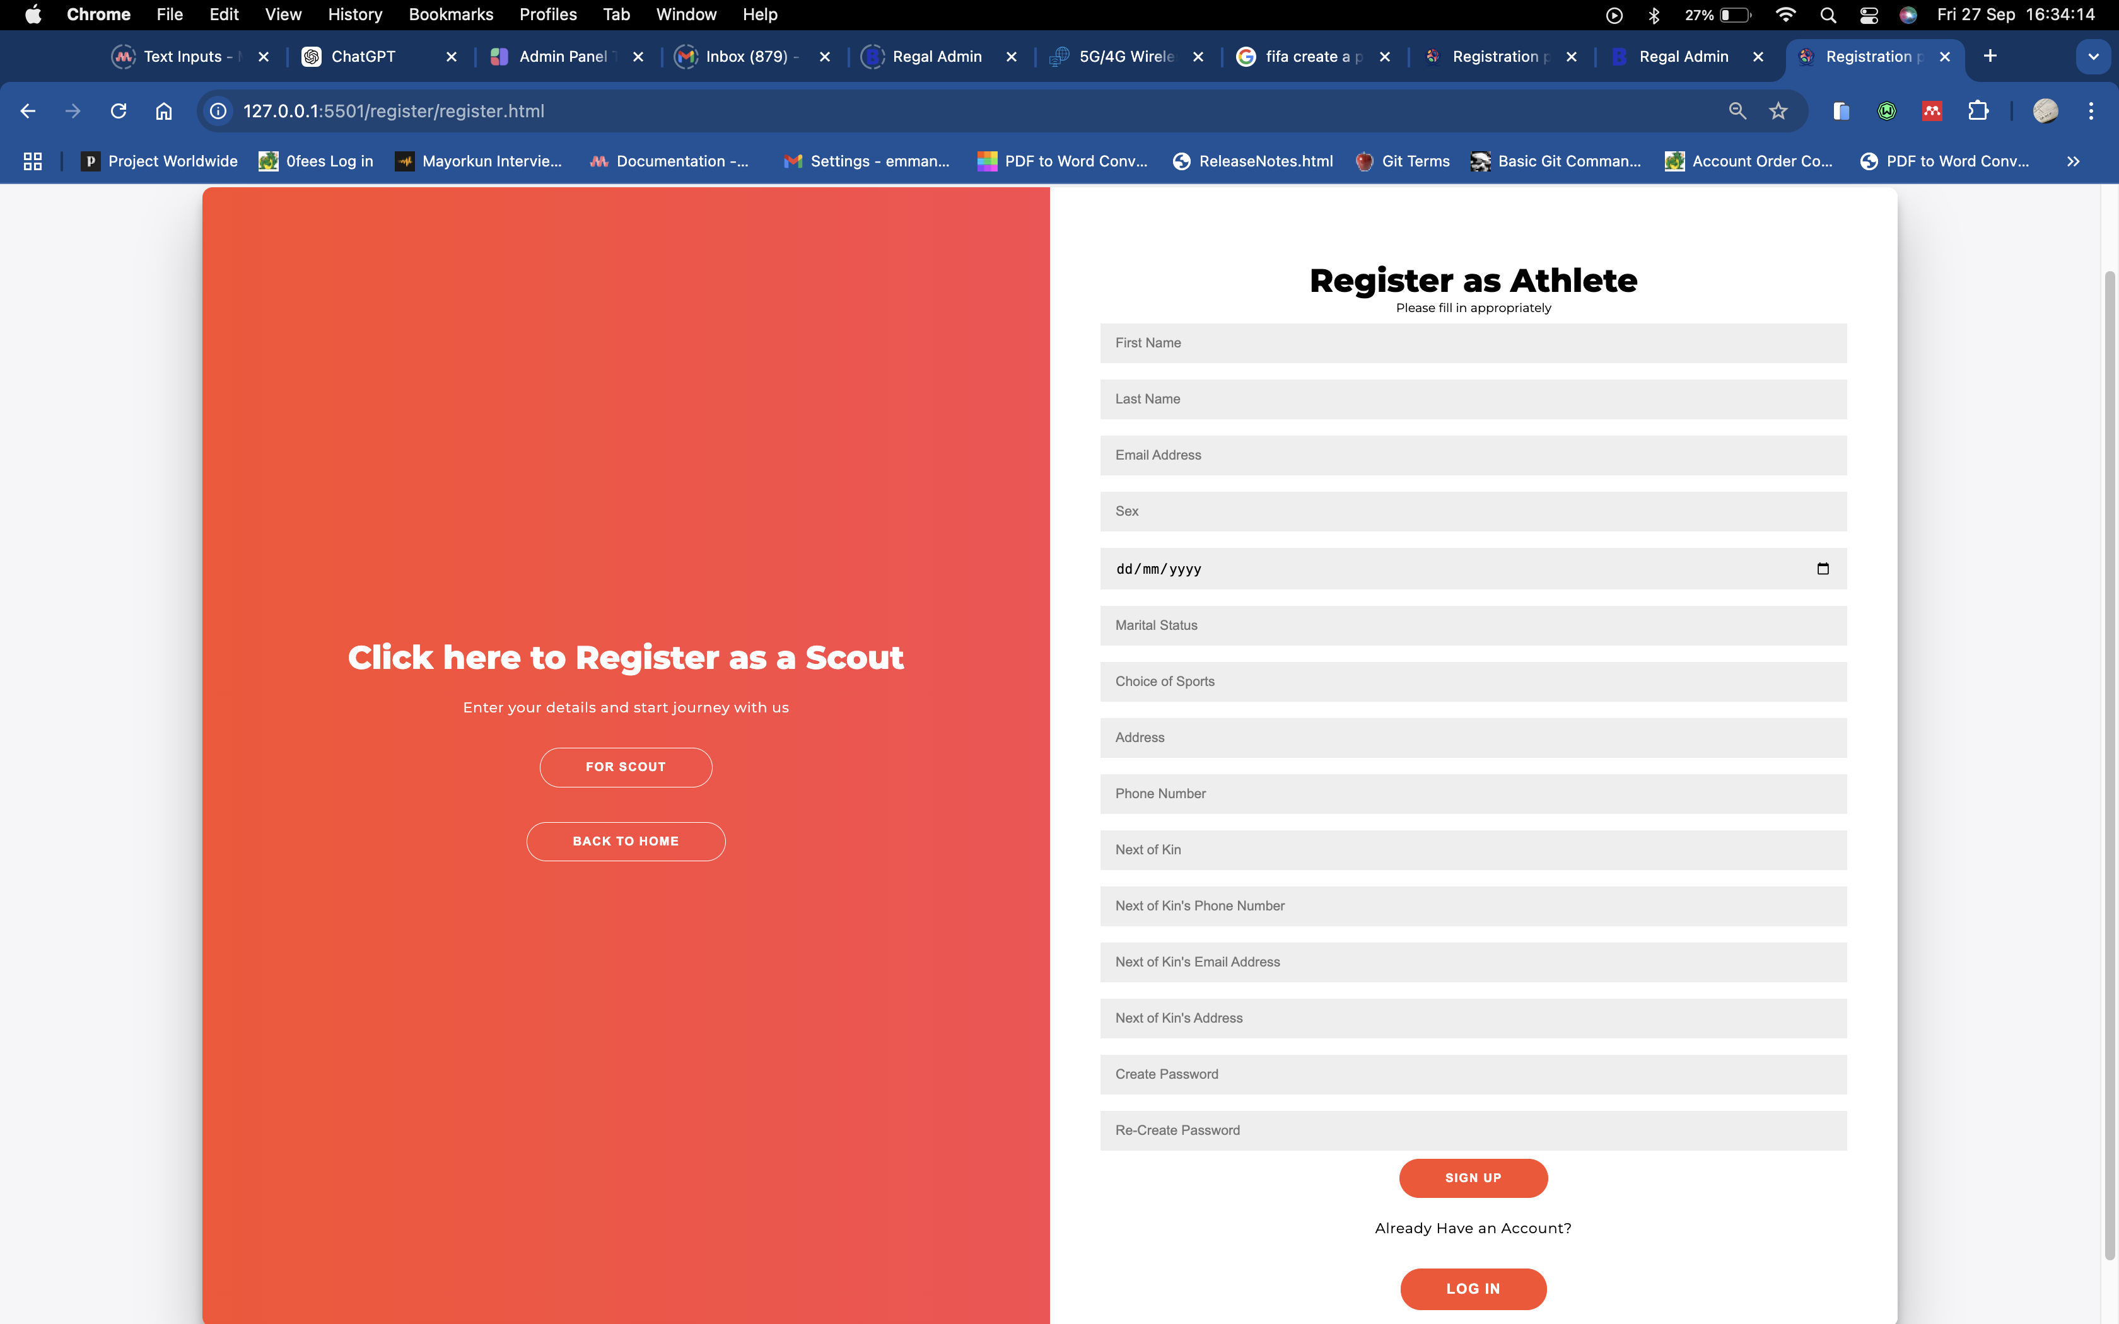
RESULTS
Athlete Registration Page:

Slide 20
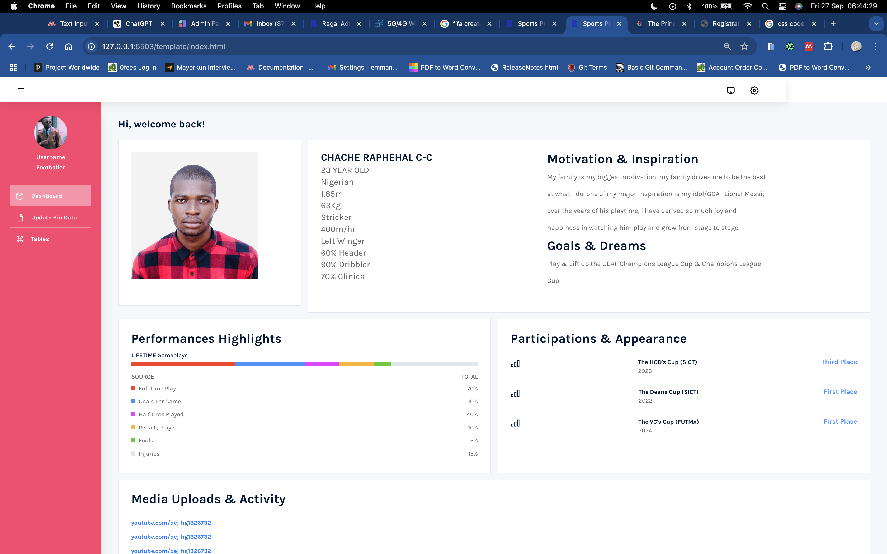
RESULTS
Athlete Dashboard Page:

Slide 21

RESULTS
Athlete Bio Data Page:

Slide 22
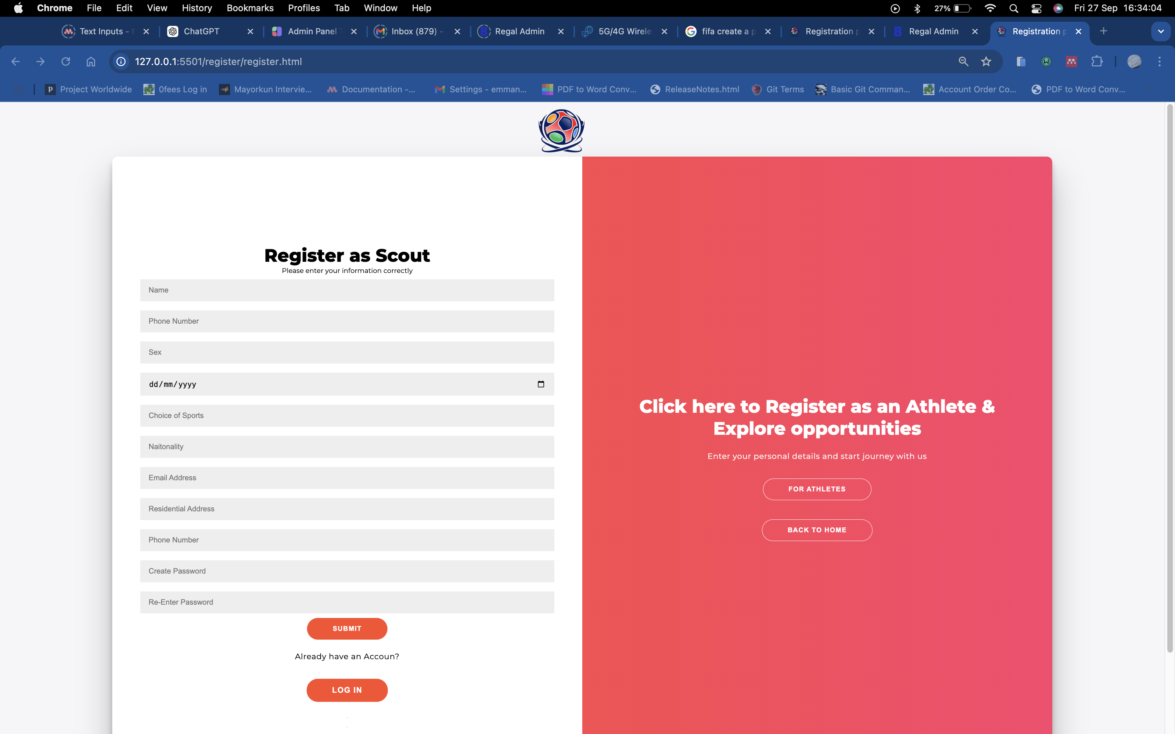
RESULTS
Scout Registration Page:

Slide 23
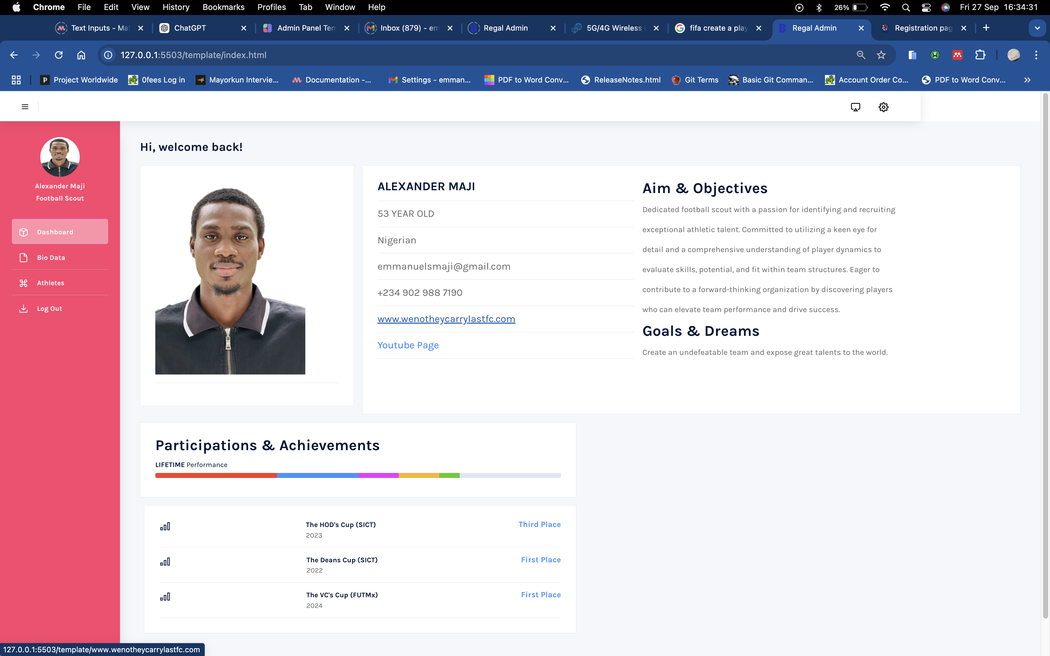
RESULTS
Scout Dashboard Page:

Slide 24

RESULTS
Scout Bio Data Page:

Slide 25
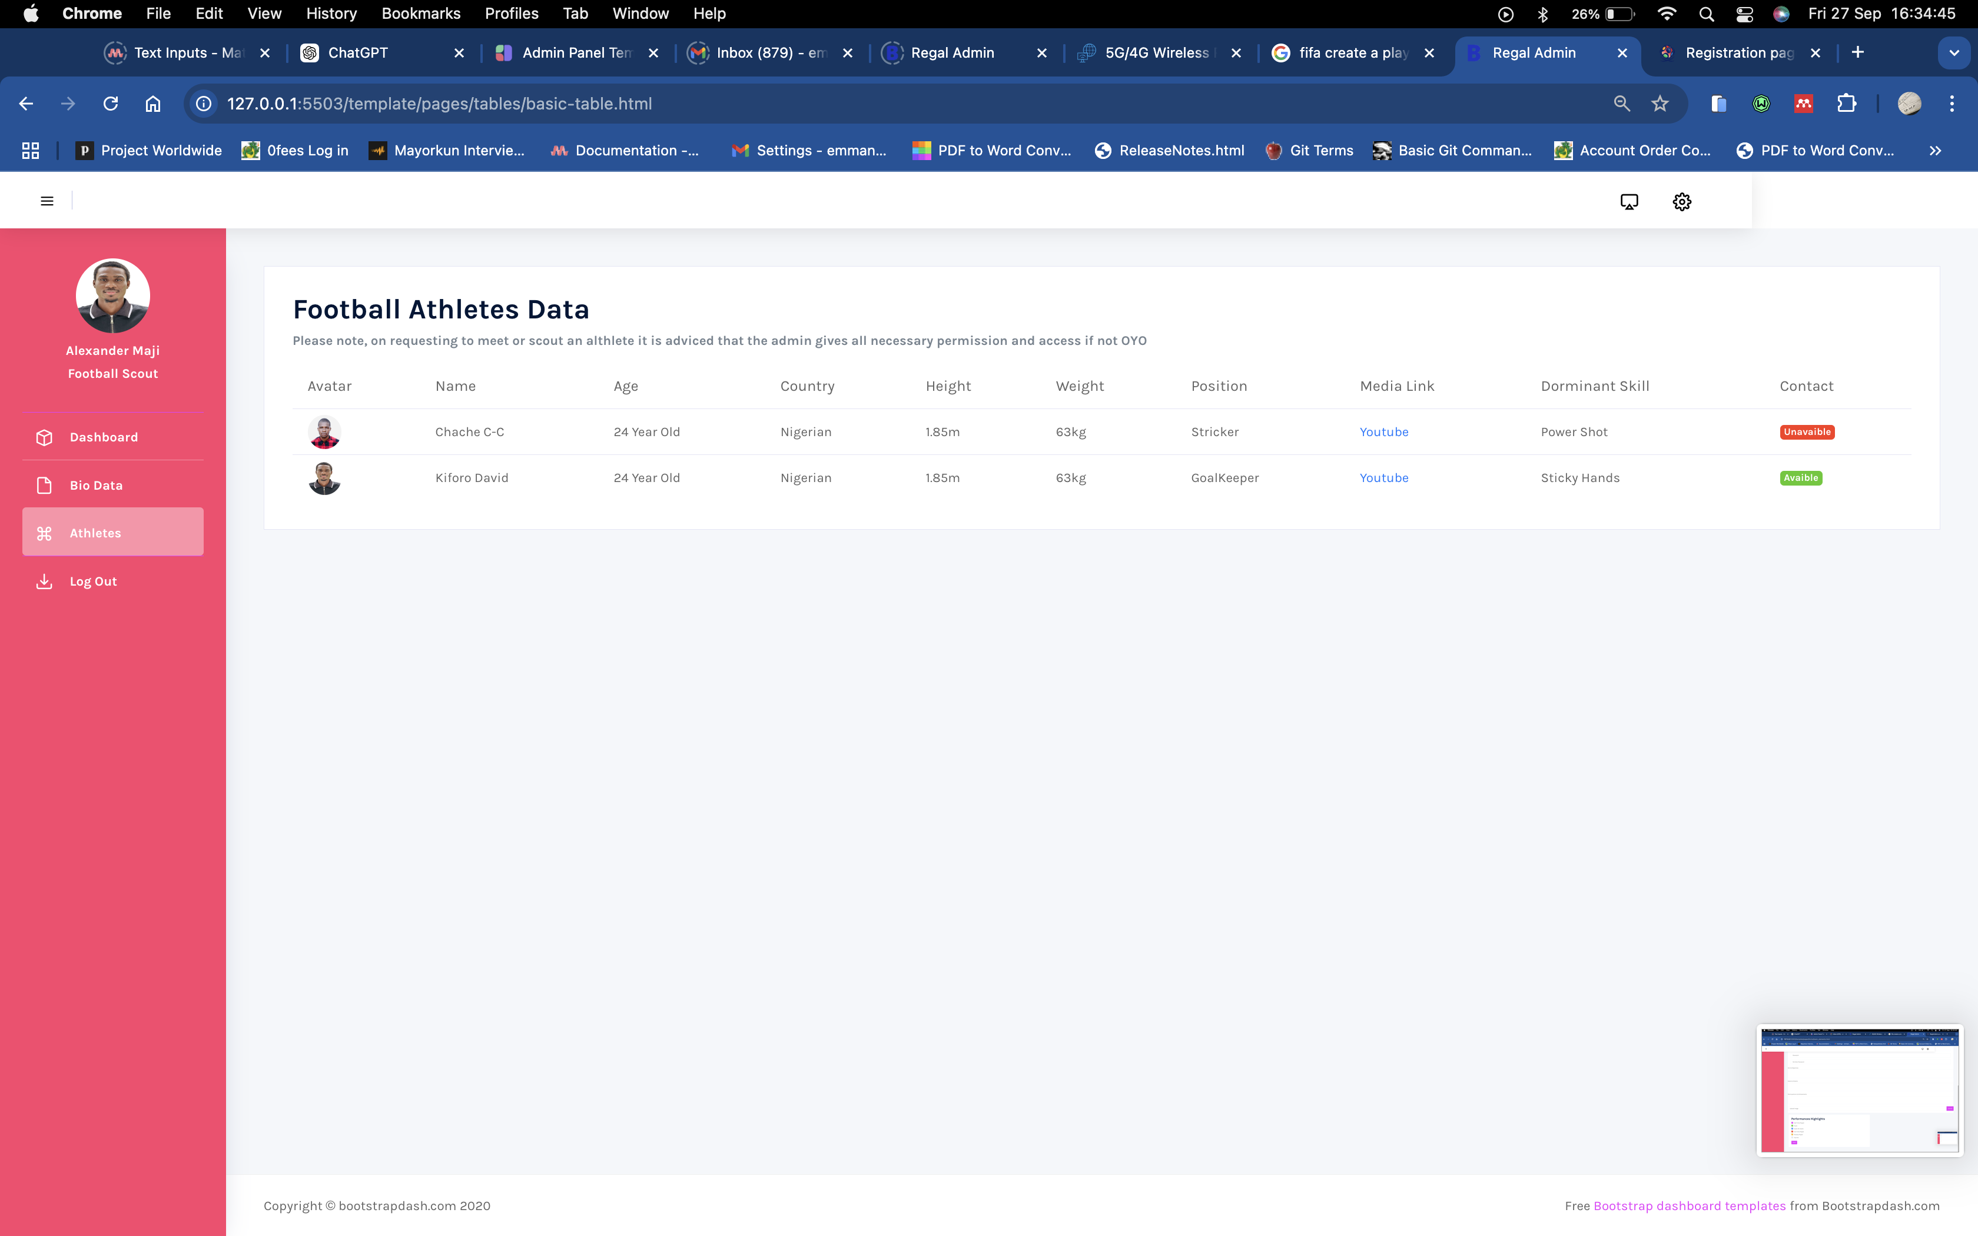
RESULTS
Scout: Athlete Database Page:

Slide 26
SUMMARY & CONCLUSION
This project concludes that no athlete with talent should be hidden from the world regardless of their financial, educational and family background generally.

Slide 27
REFERENCES:
The Benefits of Digital Transformation in Sports Administration
Source: Journal of Sports Management and Commercialization
Citation: Smith, J., & Doe, A. (2022). The Benefits of Digital Transformation in Sports Administration. Journal of Sports Management and Commercialization, 10(3), 150-165.
Digital Innovations in Sports Management
Author: Laura P. Hartman
Citation: Hartman, L. P. (2021). Digital Innovations in Sports Management. New York, NY: SportsTech Publishing.

Slide 28
REFERENCES:
How to Implement a Digital Registration System for Sports Events
Source: SportsTech Hub
URL: sportstechhub.com
Citation: SportsTech Hub. (2023). How to Implement a Digital Registration System for Sports Events. Retrieved from sportstechhub.com.
Impact of Digital Registration Systems on Athlete Participation Rates
Source: International Journal of Sports Technology and Innovation
Citation: Nguyen, T., & Patel, R. (2023). Impact of Digital Registration Systems on Athlete Participation Rates. International Journal of Sports Technology and Innovation, 15(2), 78-95.

